Slide 1
8051
ARCHITECTURE
www.vectorindia.org

Slide 2
Features
Employs CISC, Harvard architecture
8 bit CPU
40 pin DIP(40(physical)=32_I/O+8,64(logical)=(24*2)+16)
4K on chip ROM
128 bytes of on chip RAM
128 bytes address space reserved for SFRs, available ONLY 21 bytes/sfr’s
4 ,8-bit parallel port peripherals
Two 16 bit timers/counters peripheral
Full Duplex UART serial peripheral
On-chip clock oscillator requires ext crystal
Interrupt Control logic which supports 6 sources,5 vectored interrupts
Can support up to max 64k of ROM (hence 60k ext)
Can support up to addition max 64k ex-RAM

Slide 3
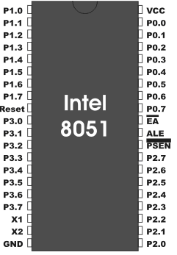
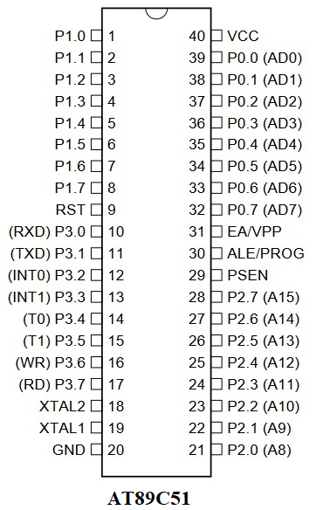
Pin-out diagram

Slide 4
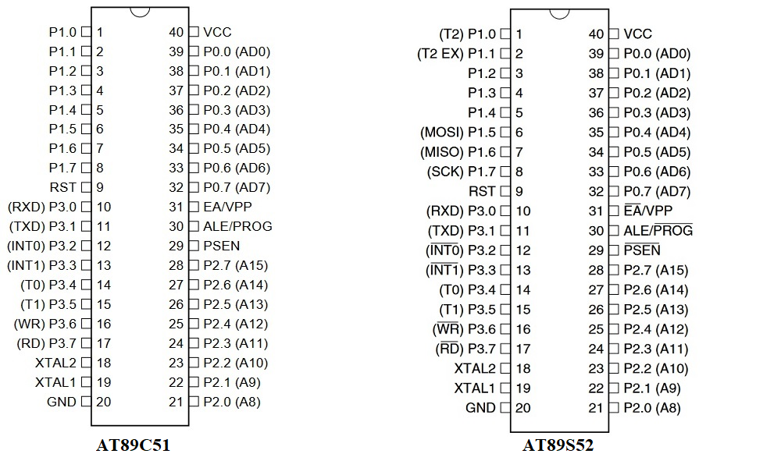
Pin-out diagram

Slide 5
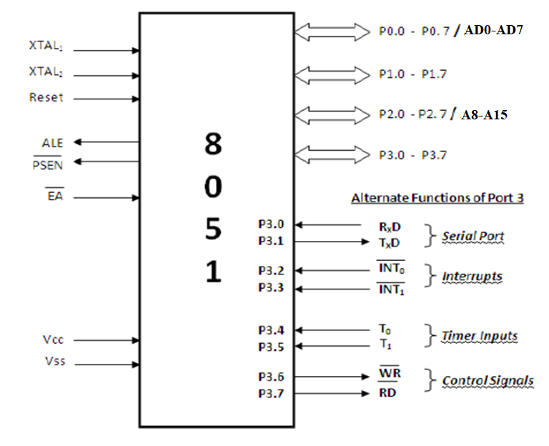
Simplified Pin Diagram

Slide 6
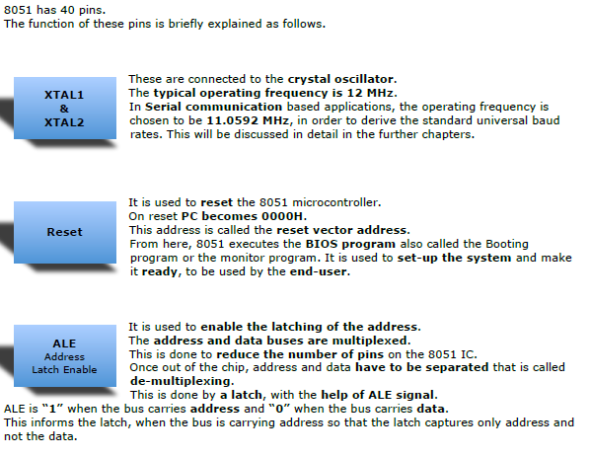

Slide 7
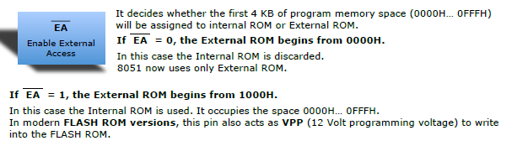
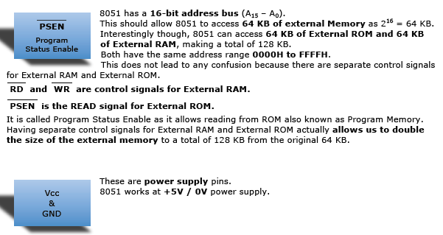

Slide 8
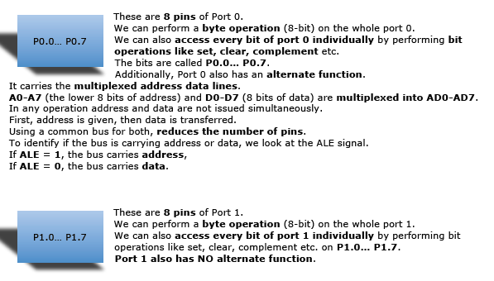

Slide 9
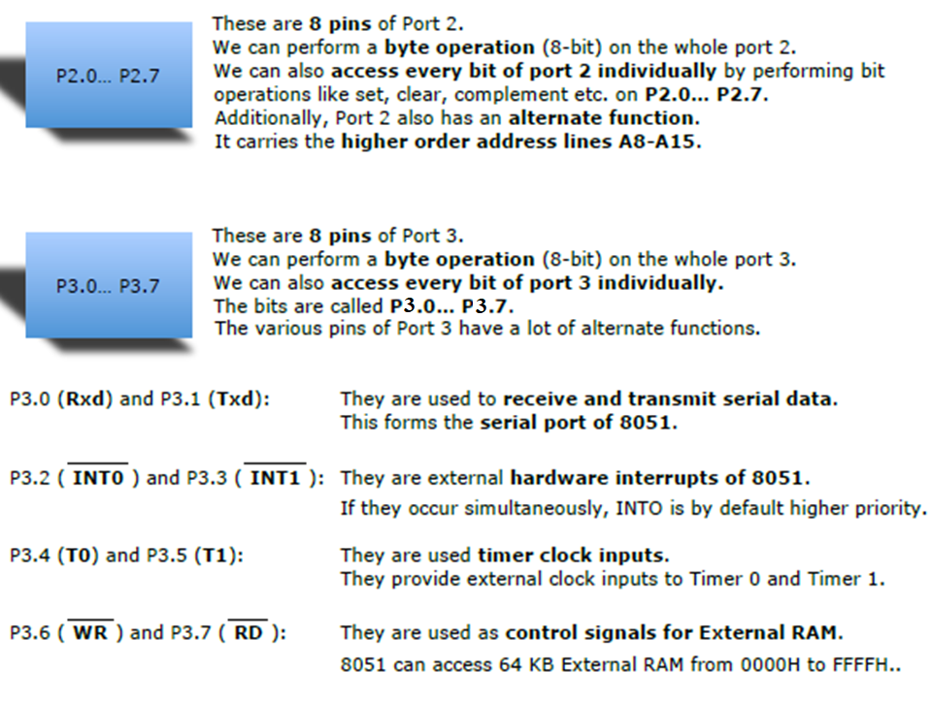

Slide 10
Power on reset circuit with switch for run time reset

Slide 11
CRYSTAL CKT

Slide 12
8051 Block Diagram
External Interrupts
Interrupt
Control
4k byte
ROM
128 byte
RAM
Timer 1
Counter
Inputs
Timer 0
CPU
OSC
Bus
Control
I/O Ports
Serial
Port
TXD
RXD
1MHz-16MHz
P0
P2
P1
P3
(Address / Data)
www.vectorindia.org

